Slide 1
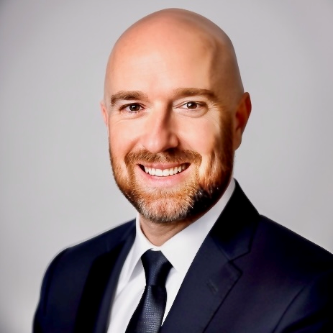
Kelly Ryan Crittenden Sr Manager — Acceleration
Email
kelly.crittenden@thebridge.com
Location
DFW, Texas
Mobile
(903) 293-2309
Kelly joined The Bridge in July 2018 and has previously worked at several technology consulting firms where he served as Enterprise Agile Coach for multiple clients, and lead dozens of development teams. His primary focus is teaching teams to achieve faster delivery of high-quality results.
EXPERIENCE
Industry Experience
Financial Services & Banking | Technology | Aerospace | Food Distribution | Retail
Management & Technology Consulting | Technology & Food Distribution
Program and Project leadership, planning and execution, reporting, and thought leadership
Business analysis, process improvement – re-engineering and deployment across multiple functional areas
Technology planning, architecture, and implementation for SharePoint solutions
Agile/Scrum Methodology implementation, training, and coaching
Enterprise Technology | Financial Services & Banking
Lead scoping, design, standardization, and ongoing administration of SharePoint environments
Provide training and learning around SharePoint to team members and bank users
Provide ownership, guidance, and execution of the Scrum process
Facilitate Daily Scrum, bi-weekly sprint planning, sprint review and retrospective meetings and backlog grooming
Technology Consulting | Aerospace & Defense, Retail
Project leadership to bring SharePoint into Sales and Service offerings for Aerospace & Defense division
Manage budget and team resources, define requirements, lead collaboration within and across divisions
Design and develop SharePoint demonstrations and specific examples of its use in A&D industry
Provide technical and functional expertise for both SharePoint on-premise and O365
BACKGROUND
Functional Skills
Agile Leadership, Strategy, and Training; Program & Project Management, Microsoft 365 Administration, Business Analysis, Information Systems Architecture, Content Management
Qualifications
Certified Agile Development Leader focused on enterprise strategy, team learning, and individual delivery. While focused on Agile, Kelly has served as Enterprise Agile Coach for multiple clients from small unified teams, to large enterprises encompassing dozens of development teams.

